Slide 1
Image: https://commons.wikimedia.org/

Slide 2

Computational Chemistry Software
https://freesvg.org/install-computer-software-cd-vector-clip-art

Slide 3

High Performance Computing (HPC)

Slide 4
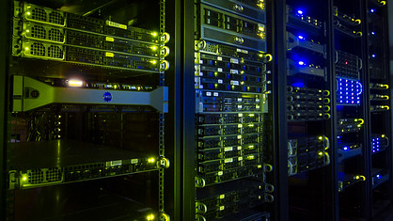
High Performance Computing (HPC)

Slide 5
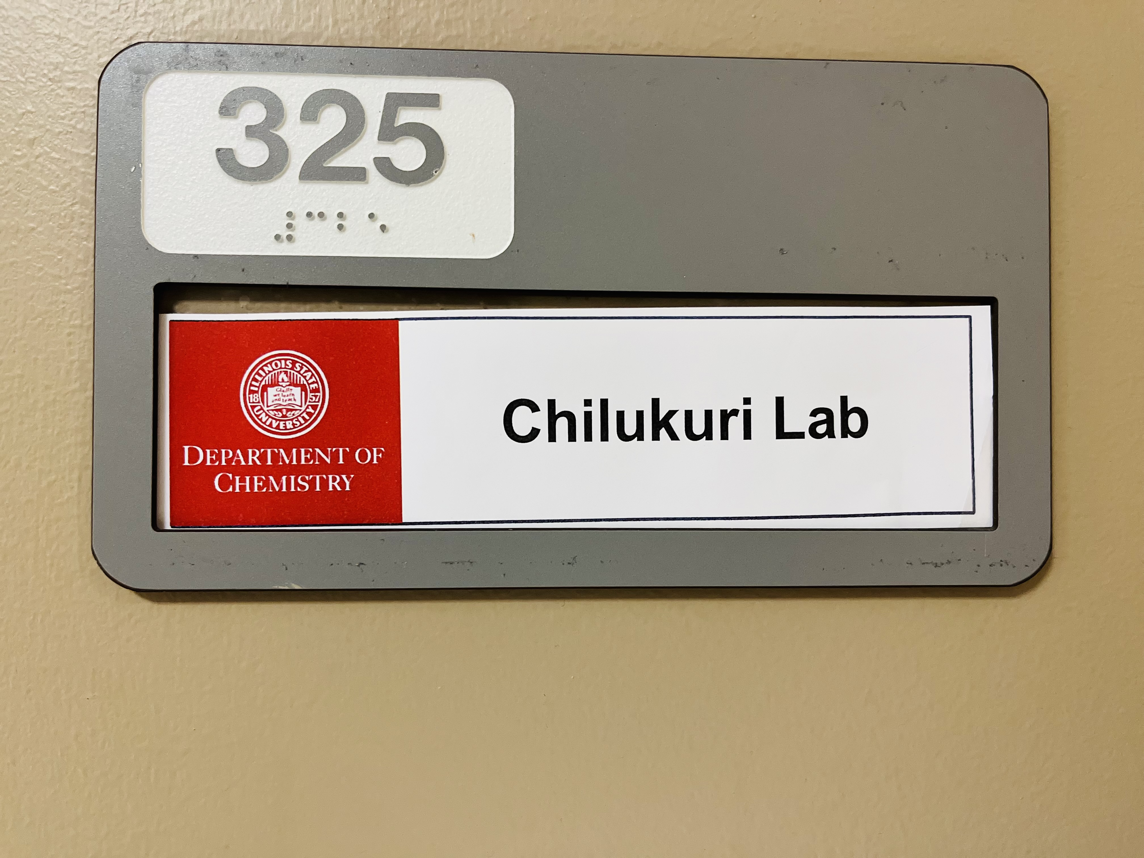
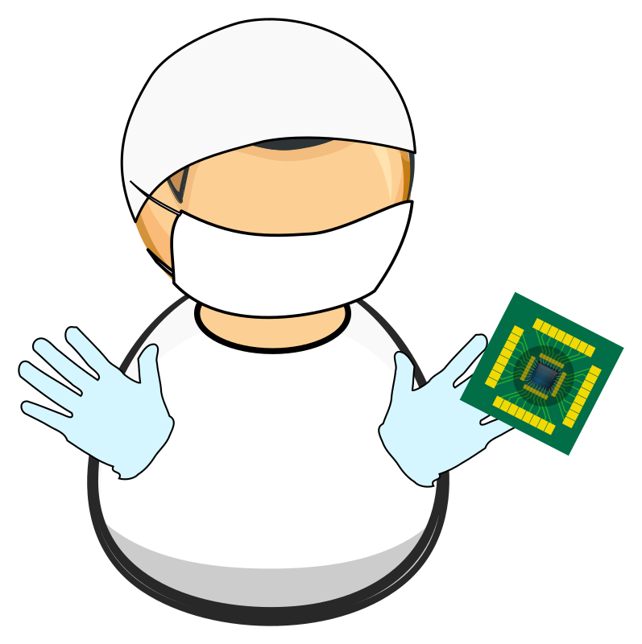
https://openclipart.org/detail/266384/clean-lab-worker

Slide 6

Chemistry meets computing

Slide 7
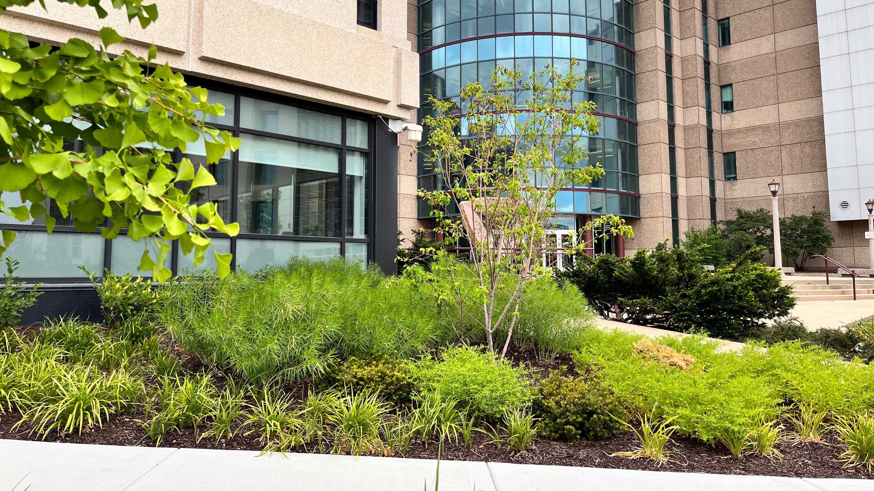
CHILLAB @ ISU

Slide 8
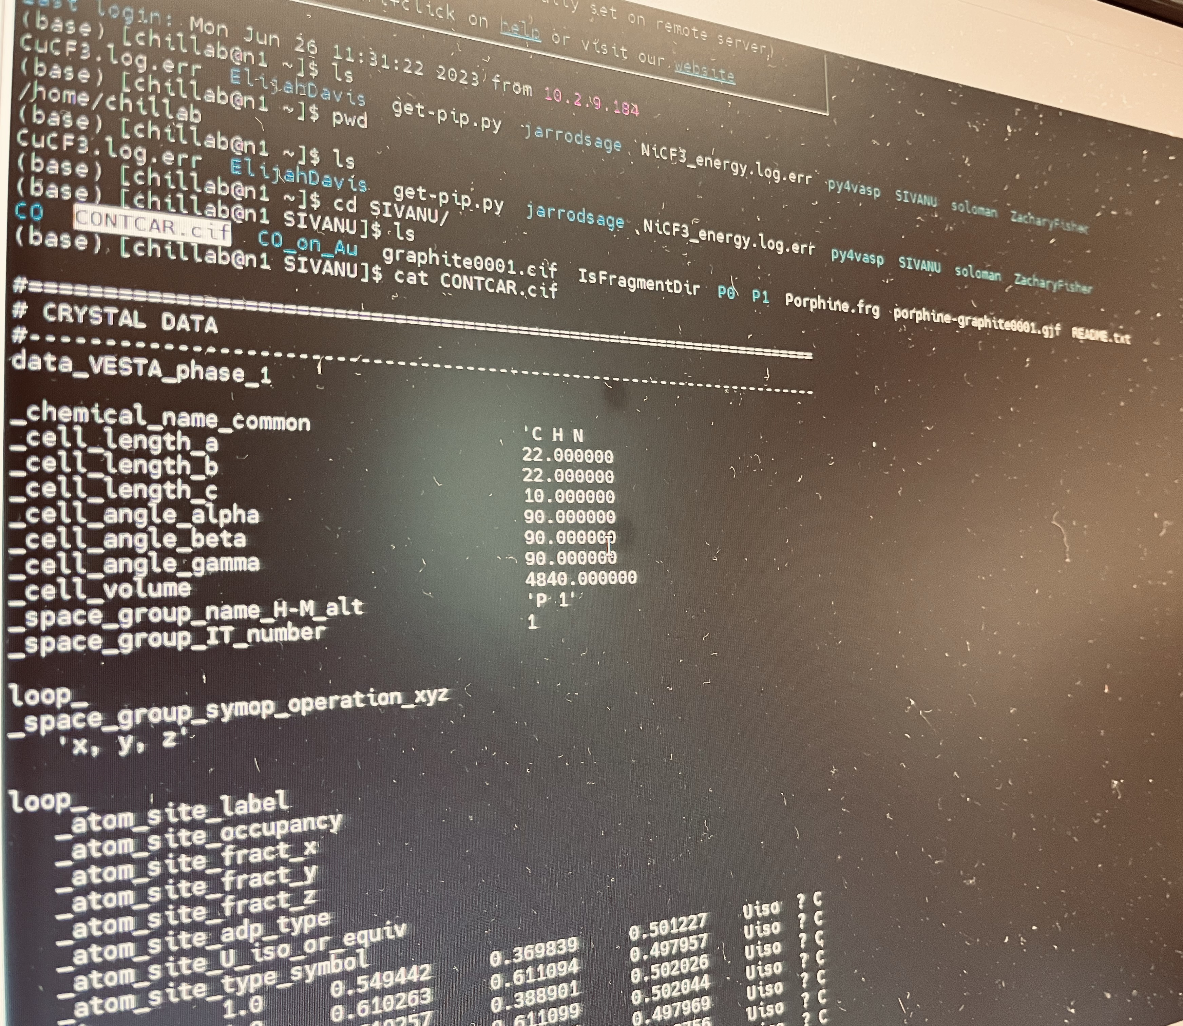
LINUX
Introduction

Slide 9
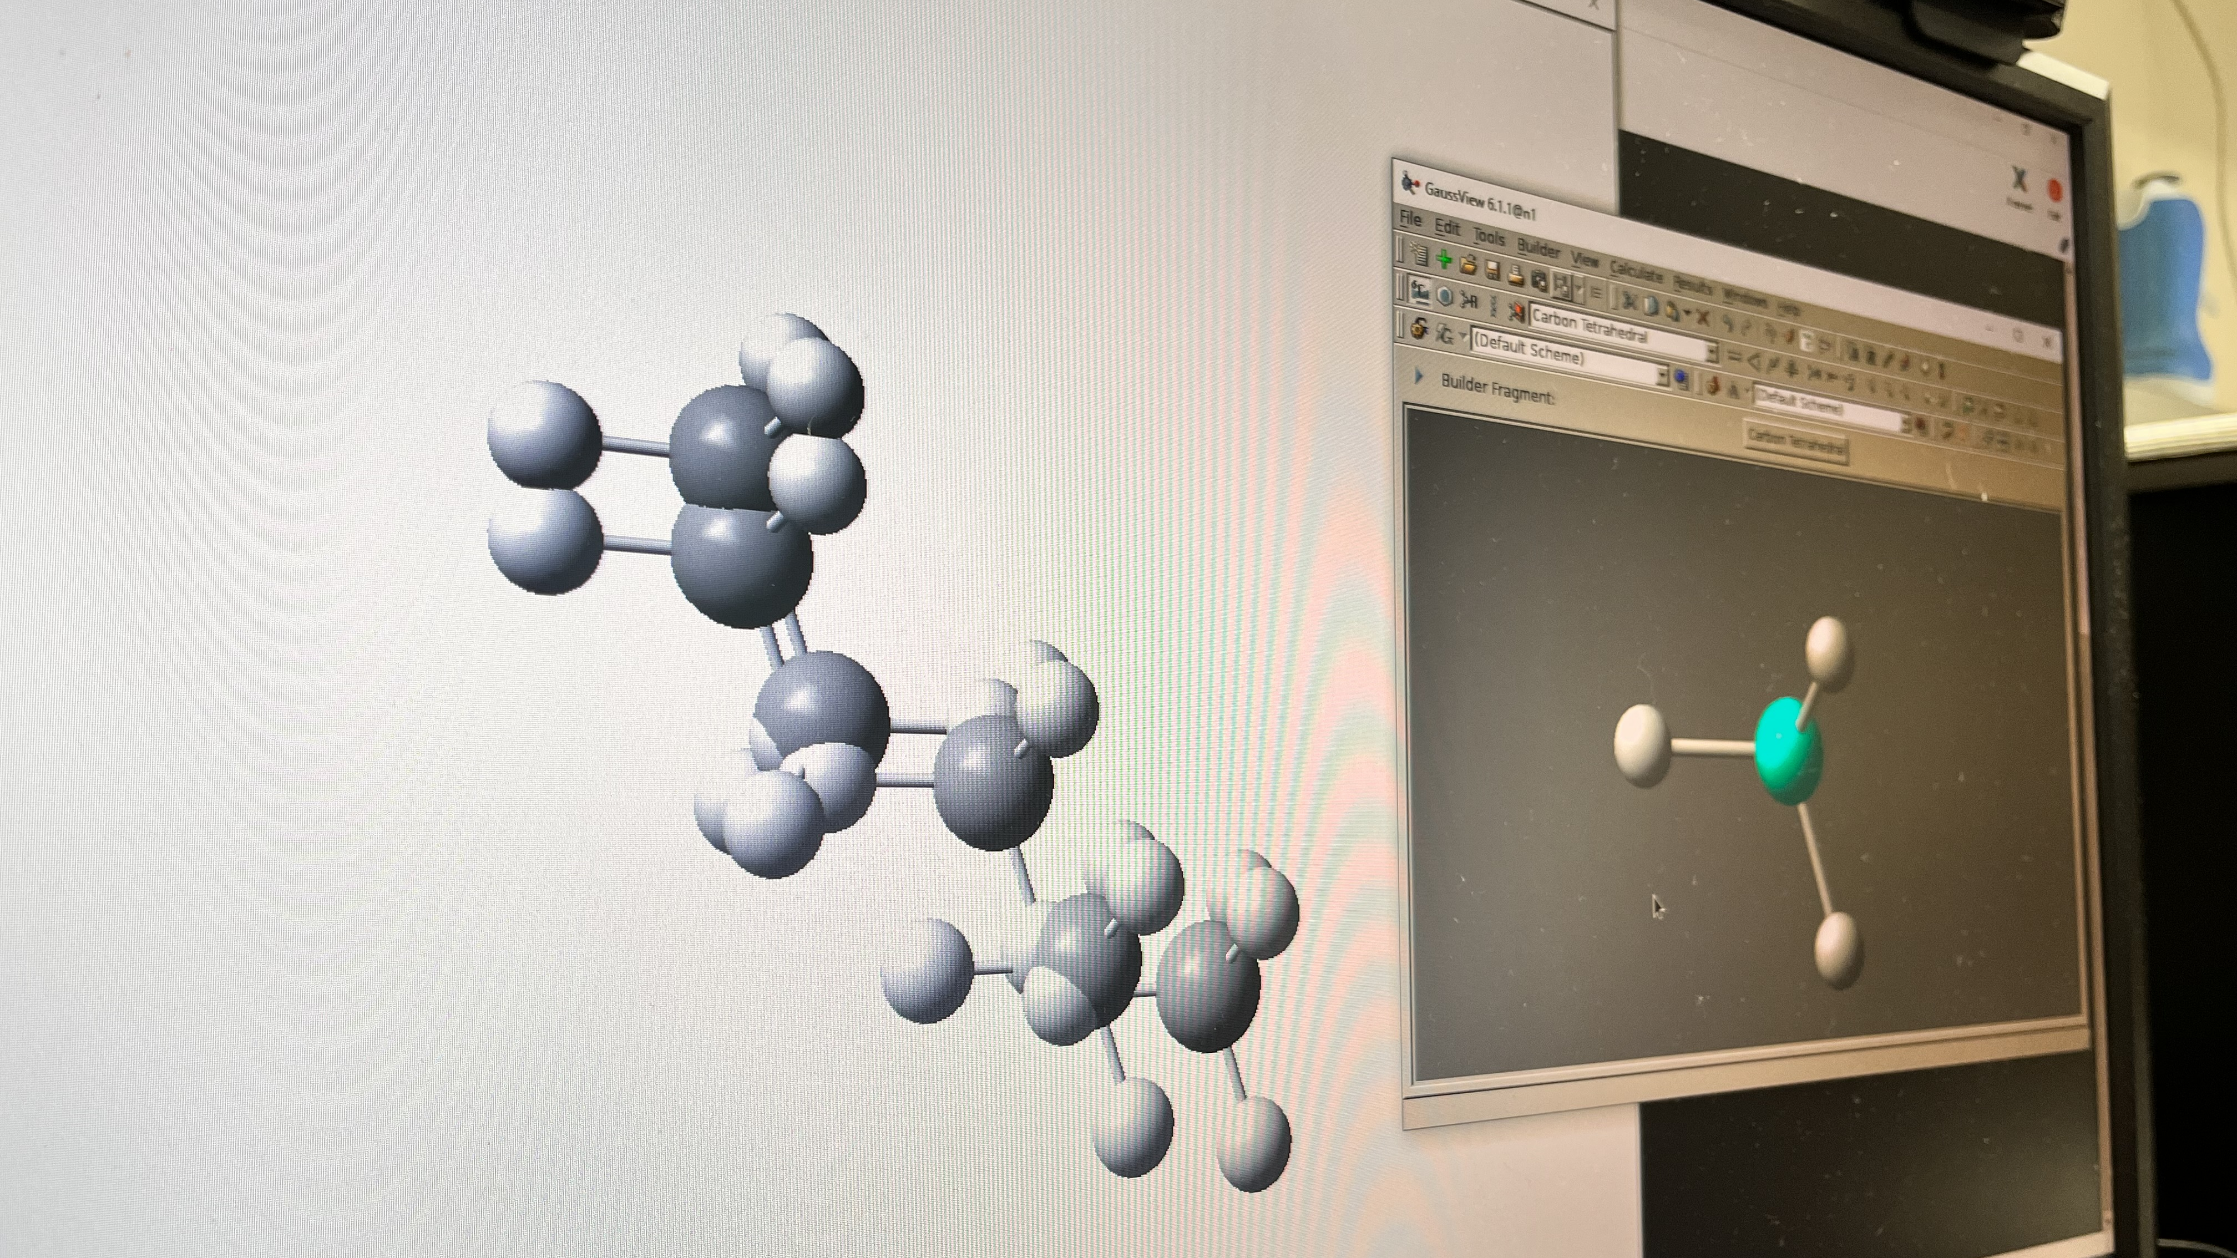
Computational Chemistry Software

Slide 10
High Performance Computing (HPC)

Slide 11
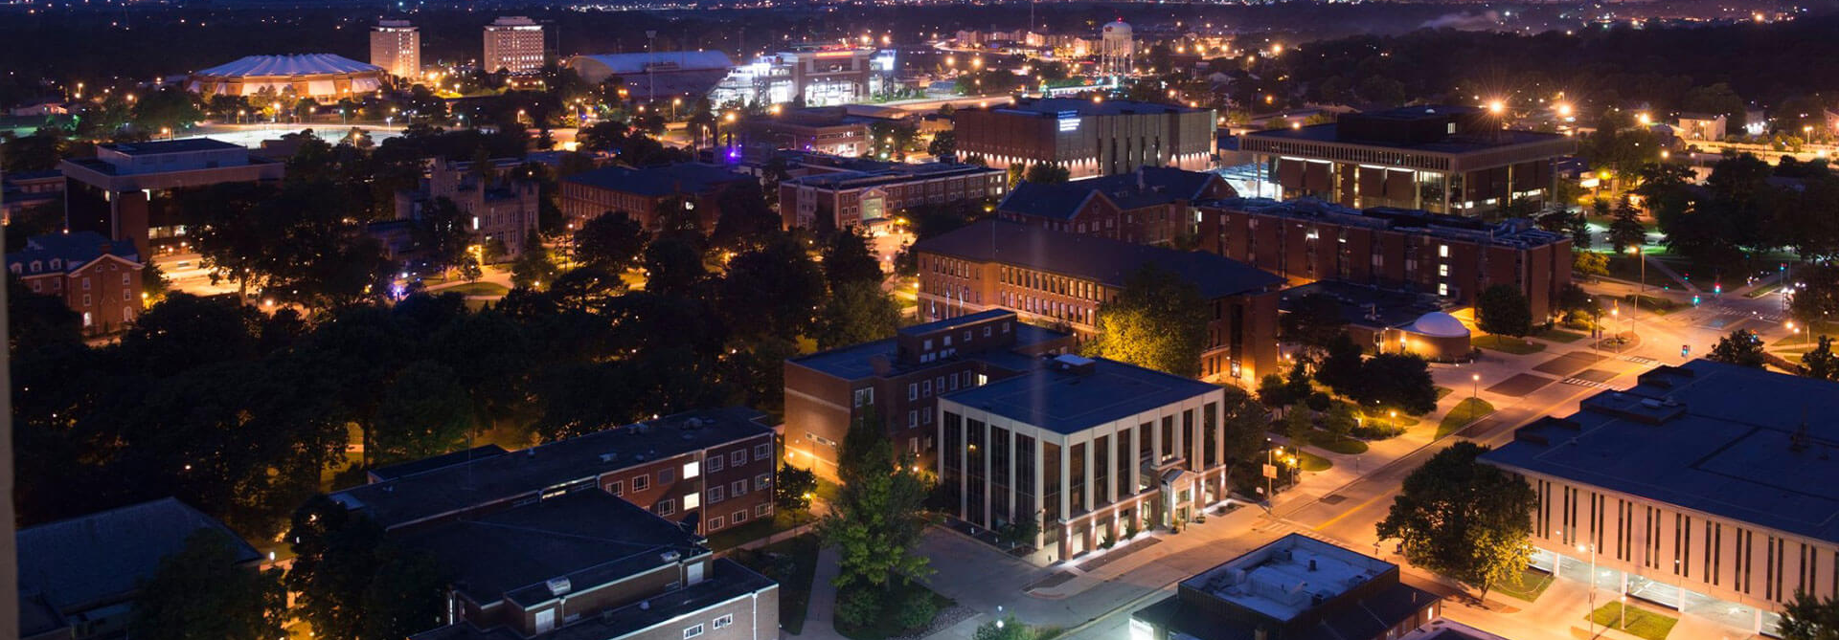


Slide 12
